Slide 1

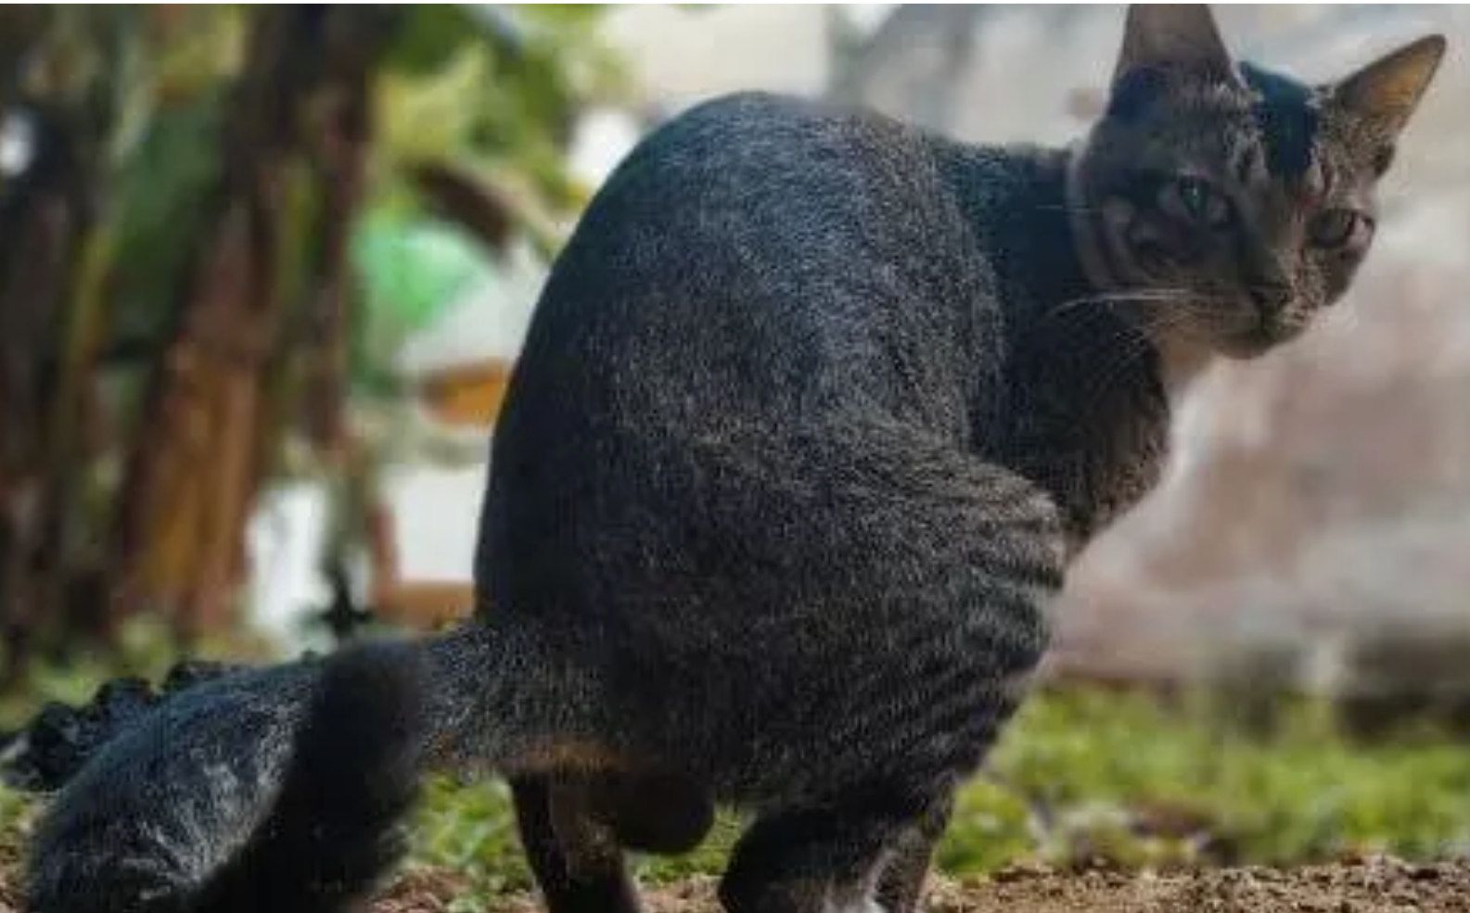
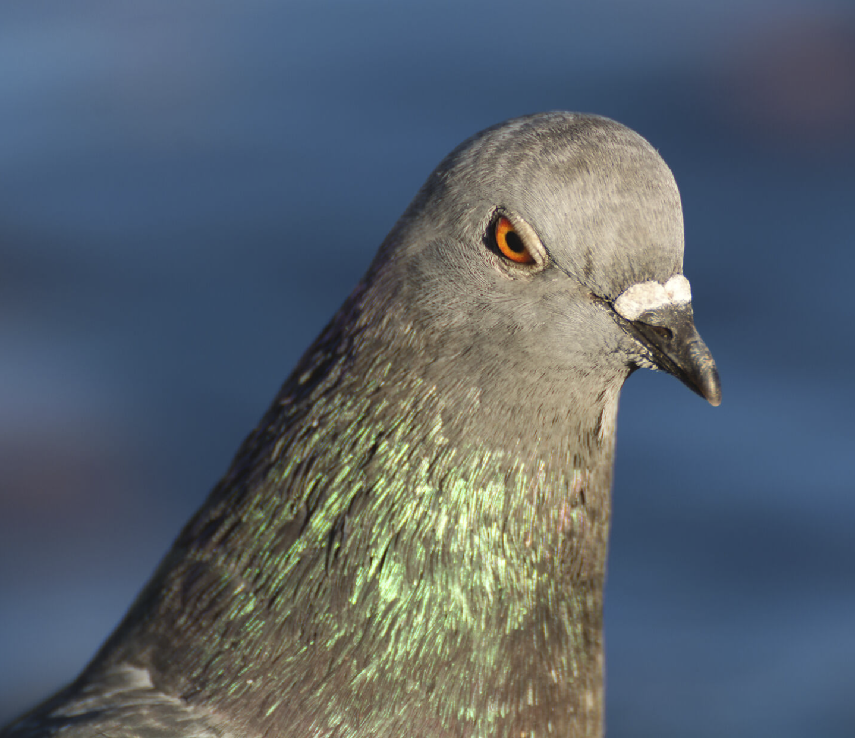
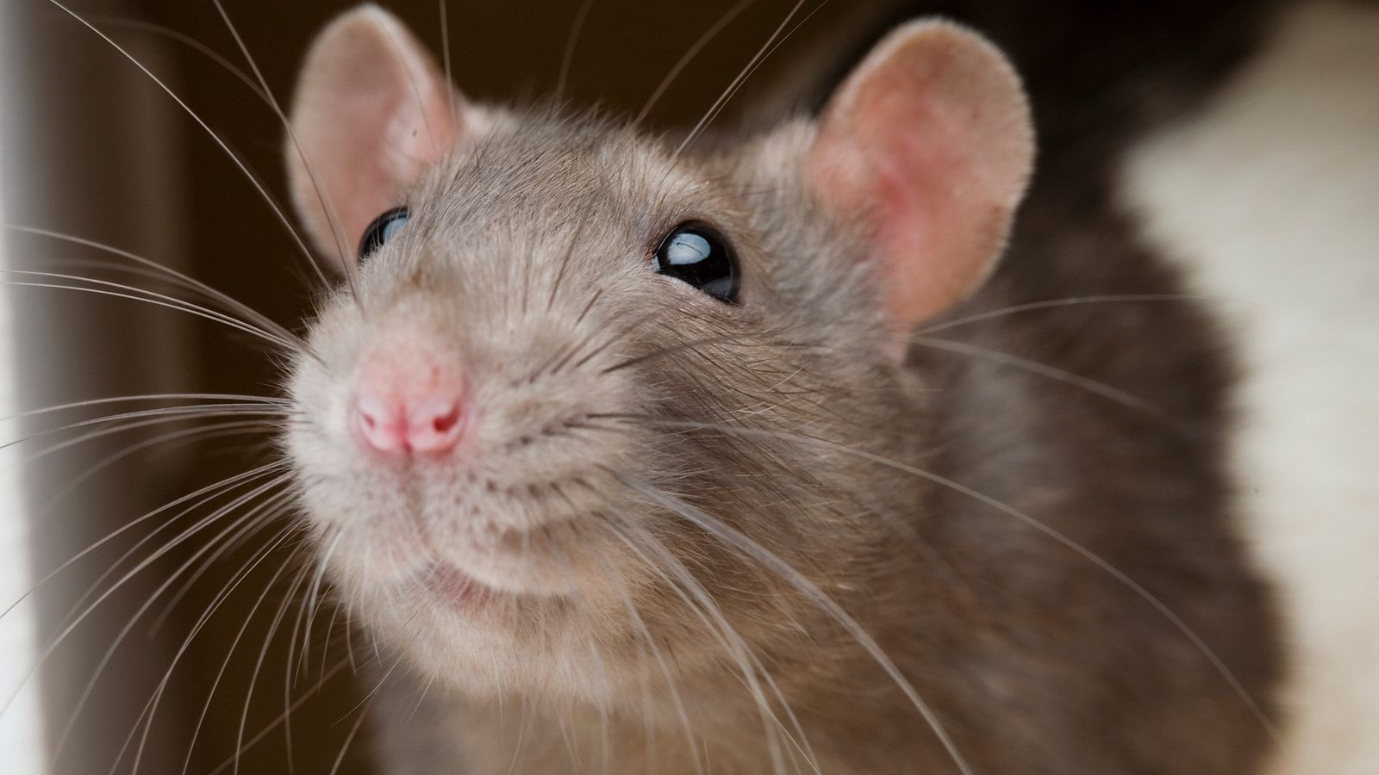
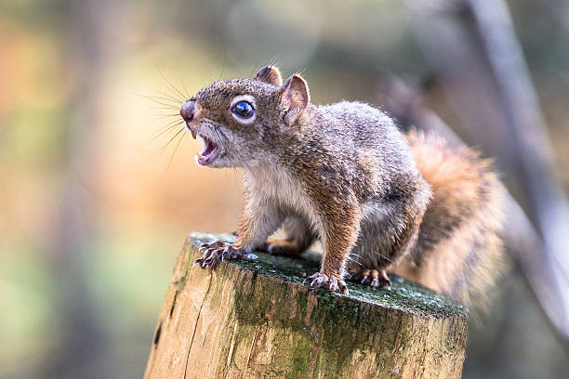
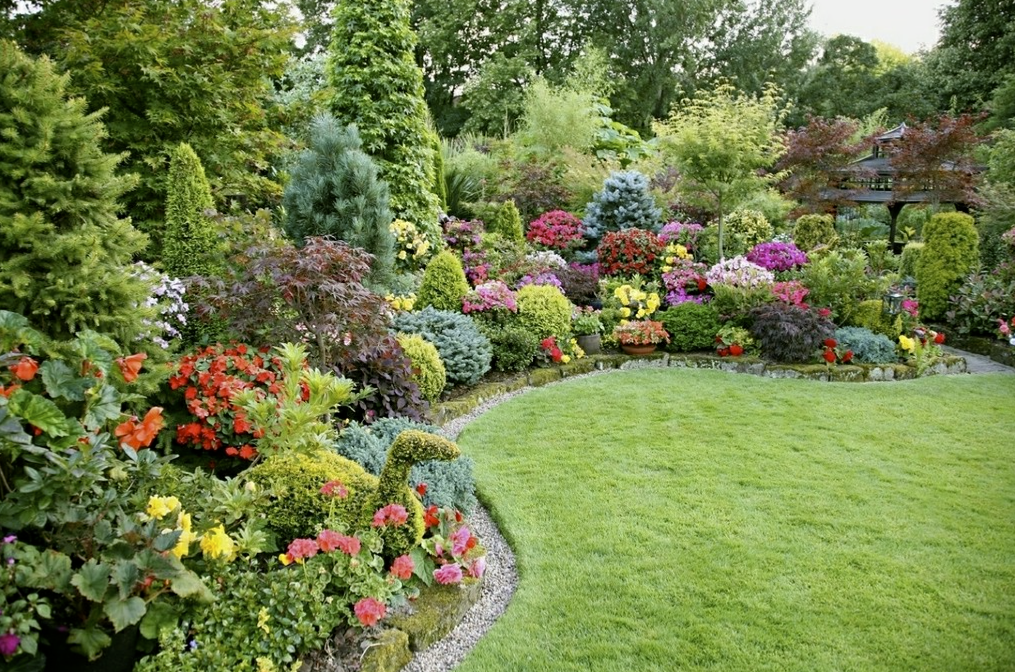
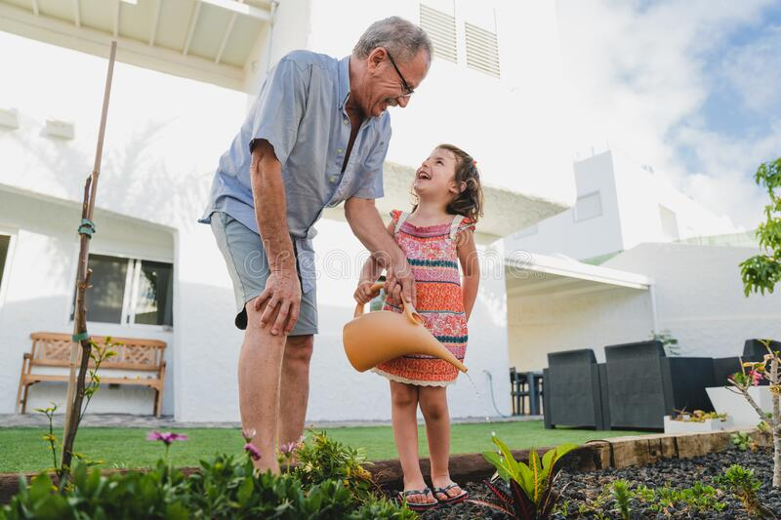
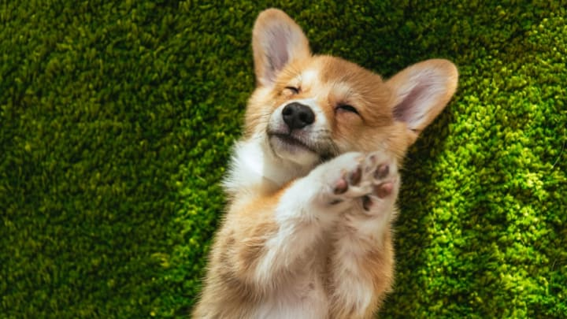
GARDEN DEFENDER: Robotic garden deterrent Protect your garden
Unwanted garden guest
Detects, aims and shoot!
Damage gardening
Unwanted “presents”
SHOOT
GARDEN
Camera
Friend – don’t shoot
Protect
Protect your garden

